Slide 1

COURSE TITLE: ENTREPRENEURSHIP & Technology Commercialization
Course Code: CS391
Course Instructor: Dr. Fahd S. Khan
Ghulam Ishaq Khan Institute Of Engineering Sciences and Technology

Slide 2
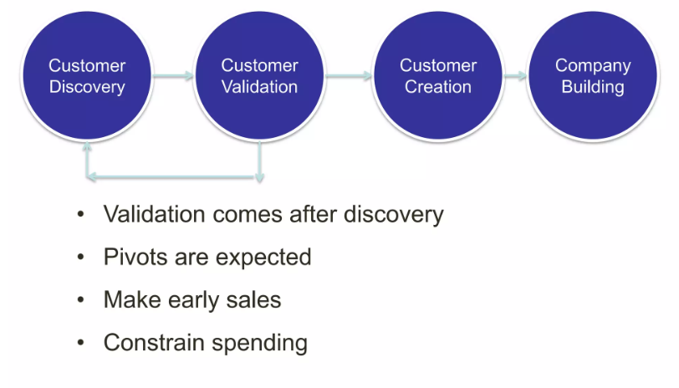
Customer Identification & Validation

Slide 3
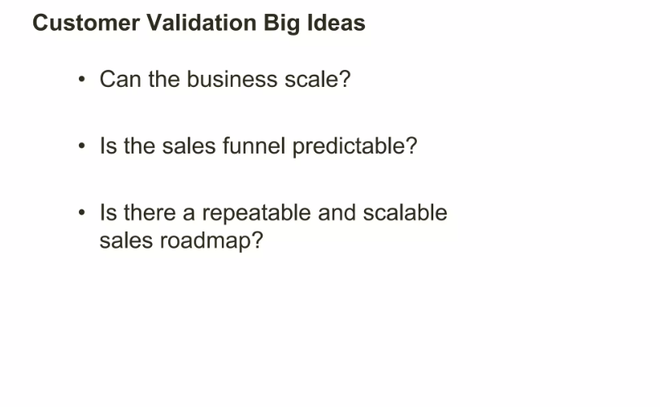

Slide 4
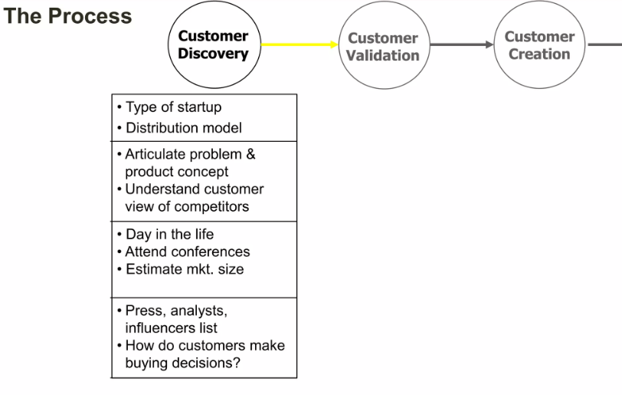

Slide 5
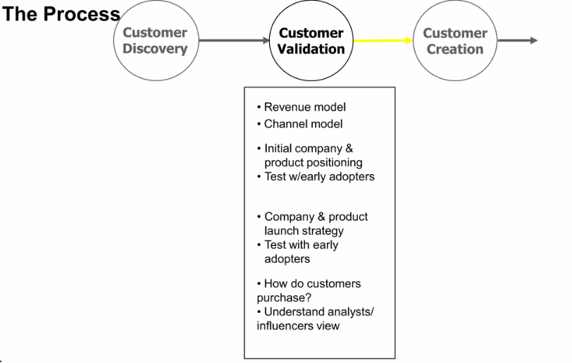

Slide 6
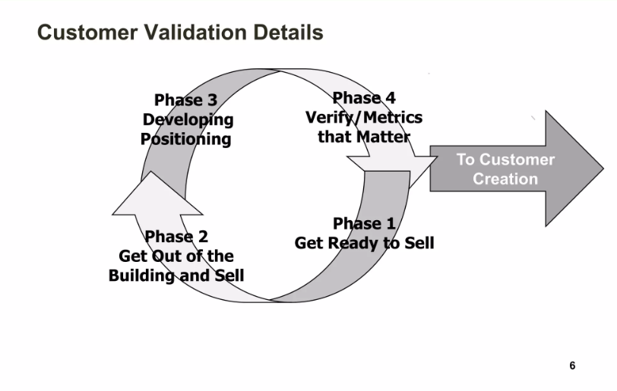

Slide 7
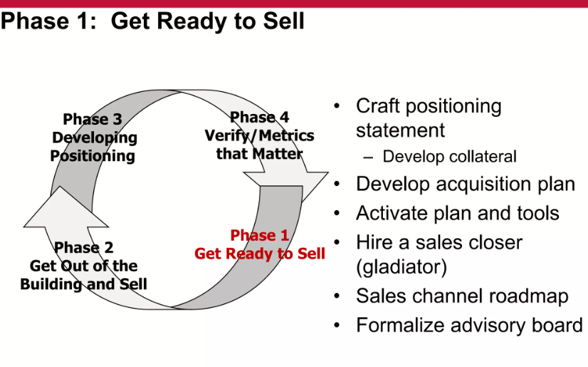

Slide 8
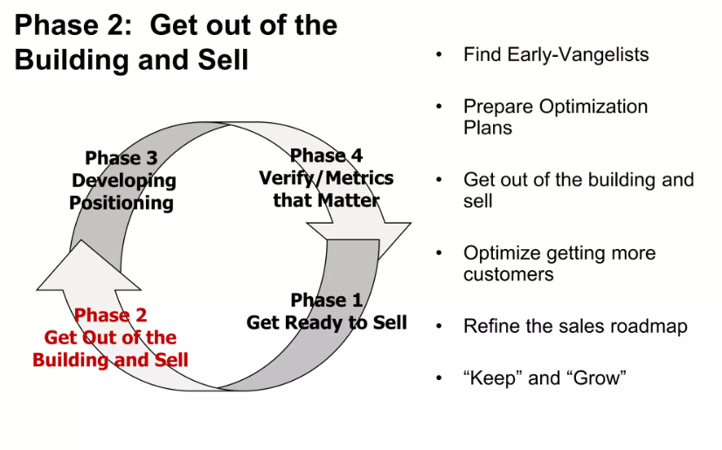

Slide 9
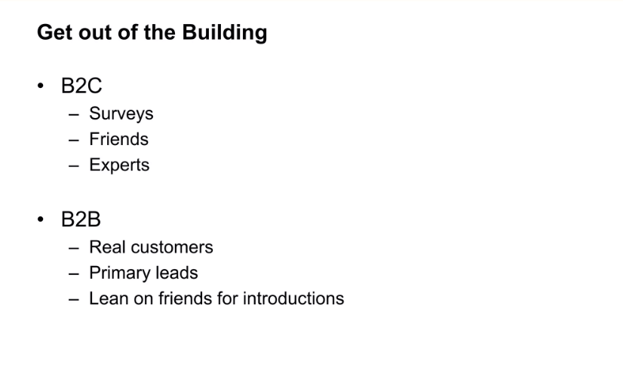

Slide 10
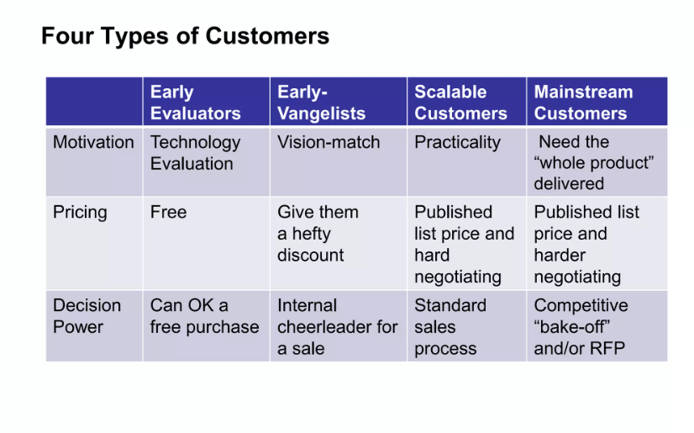

Slide 11
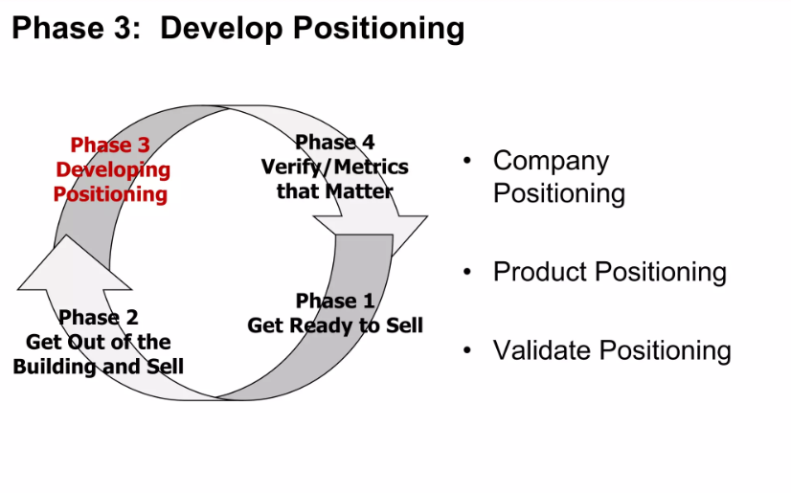

Slide 12
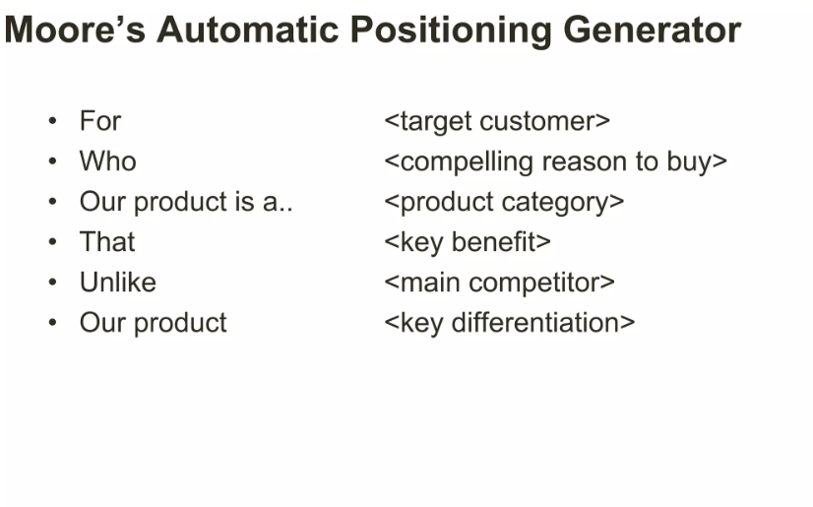

Slide 13
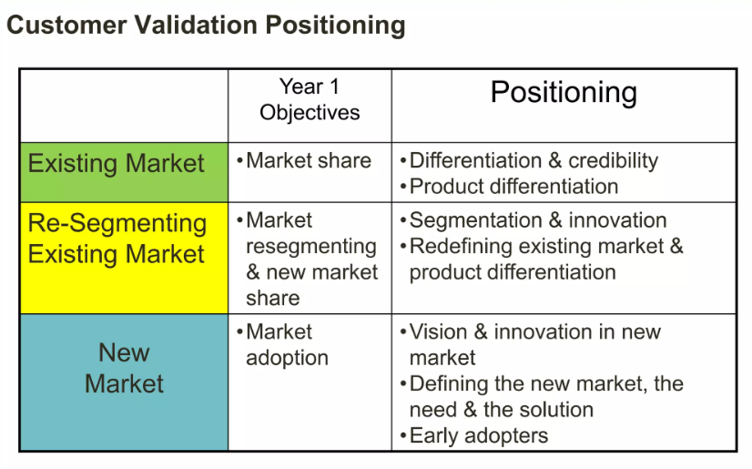

Slide 14
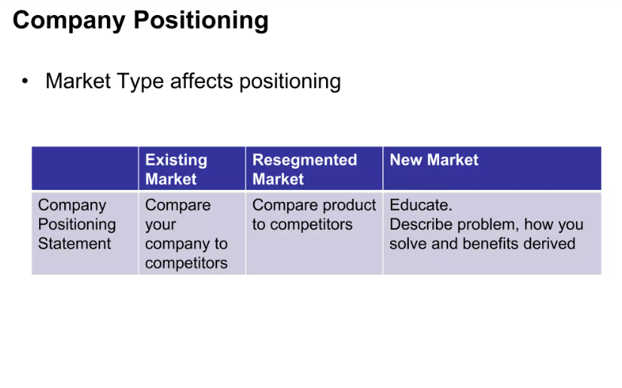

Slide 15
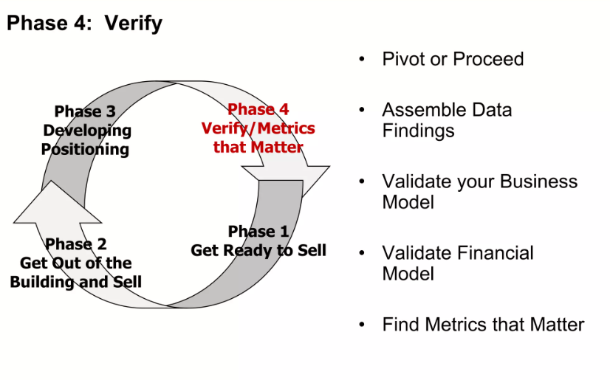

Slide 16
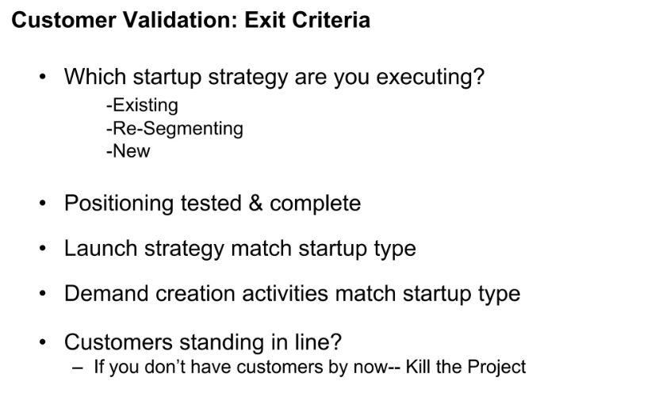

Slide 17
Class Activity
Step 1: Define the product/service and the assumed customer Pain Point (from a previous assignment).
Step 2: Create the profile of the ideal Early-Evangelist.
Step 3: Craft the Positioning Statement using the Moore's Generator framework.
Step 4: Roleplay - Each team performs a 60-second "Evangelist Pitch" to the group (evangelist) sitting next to them.

